Slide 1
The paradox of progress
Mungo Wilson

Slide 2
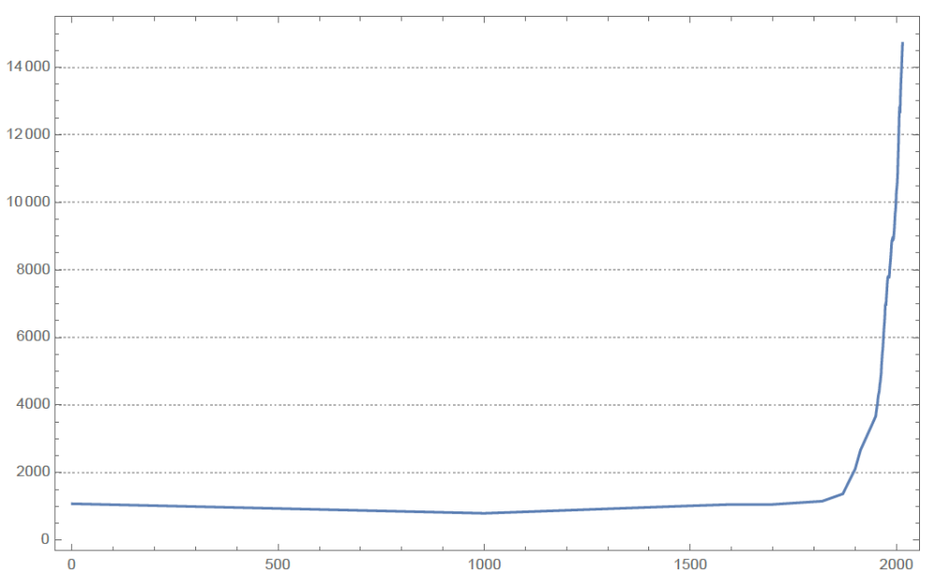
World GDP per capita since 1 AD
Source: Koppl et al. (2018) using data from the Maddison Project Database, version 2018.

Slide 3
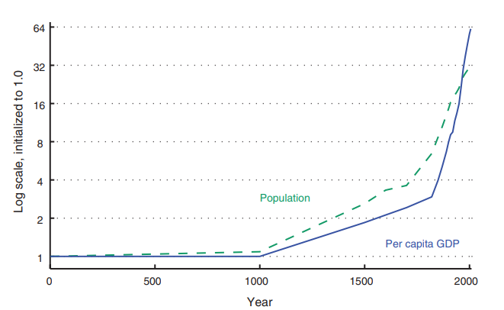

Slide 4
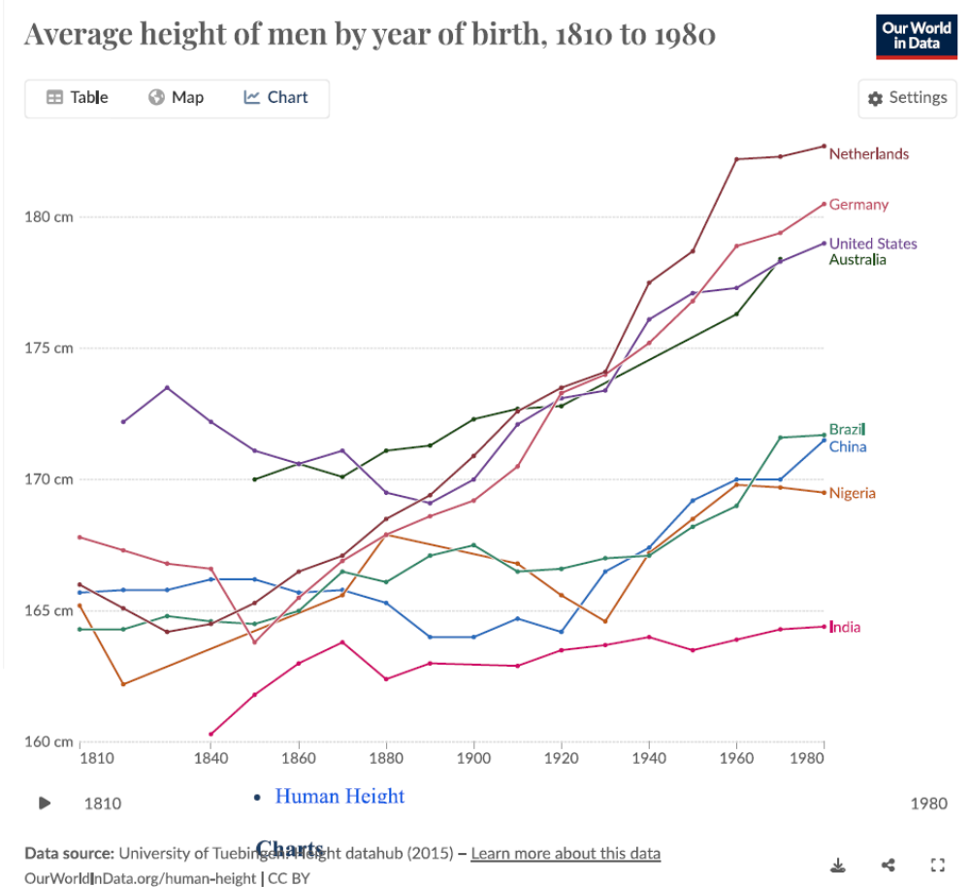
Source: Koppl et al. (2018) using data from the Maddison Project Database, version 2018.

Slide 5
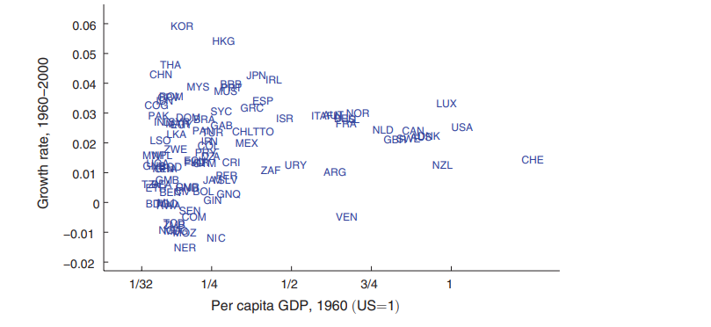

Slide 6
From the earliest times of which we have record-back, say, to two thousand years before Christ-down to the beginning of the eighteenth century, there was no very great change in the standard of life of the average man living in the civilised centres of the earth. Ups and downs certainly. Visitations of plague, famine, and war. Golden intervals. But no progressive, violent change. Some periods perhaps 50 per cent better than others, at the utmost 100 per cent better-in the four thousand years which ended (say) in A. D. 1700.
This slow rate of progress, or lack of progress, was due to two reasons-to the remarkable absence of important technical improvements and to the failure of capital to accumulate.
The absence of important technical inventions between the prehistoric age and comparatively modern times is truly remarkable. Almost everything which really matters and which the world possessed at the commencement of the modern age was already known to man at the dawn of history. Language, fire, the same domestic animals which we have to-day, wheat, barley, the vine and the olive, the plough, the wheel, the oar, the sail, leather, linen and cloth, bricks and pots, gold and silver, copper, tin, and lead-and iron was added to the list before 1000 B.C.-banking, statecraft, mathematics, astronomy, and religion. There is no record of when we first possessed these things. Keynes, 1930

Slide 7
The remarkable absence of important technological improvements
Roman Empire invented: Concrete, sewage and water distribution, even unbreakable glass
Tang dynasty (1,500 years ago) invented: Clockwork, gas ovens, printing
Mechanical knitting frame invented in reign of Queen Elizabeth I (died 1603)
We didn’t suddenly become better at inventing technological improvements around 1740!
So, what changed?

Slide 8
So, why don’t we all feel lucky?
Material well-being may not be only, or even most important, component of human well-being.
Technological progress requires creative destruction, which requires losers. What if most of us are losers?
Mokyr emphasizes need for culture that accepts and permits technological change and (some) rents for the winners. Many cultures, historically, did not and do not tolerate this.
Environmental cost of growth.
Inequality – but why should we care?
Notes:
5 – Answer: The rat race. But why is there a rat race?

Slide 9
Research Question
Why do people care about inequality?
Inequality aversion:
  People vote for massive government spending on public services favouring disadvantaged groups (Saez (2021)).
Keep up with/Get ahead of Joneses:
  Preference for higher social status (Abel (1990), Roussanov (2010), DeMarzo et al., (2008))
  Assume an exogenous dependence of the utility function on relative wealth;
What can be a minimal departure from the standard endowment economy required to generate inequality concerns?
  What else is different?

Slide 10
Research Question: Why don’t I feel lucky?
Think about two people, Alice and Bob, competing to buy Charlie’s house, who wants to sell it. Half a house is useless.
Sound familiar?
Alice can only get the house if she outbids Bob, and vice versa.
For expositional purposes we don’t need Charlie. Just assume Alice and Bob own half each of the house. Makes everything much simpler.
Notes:
Why is half a house useless? Ownership of a house confers rights to and powers of ‘quiet enjoyment’. These rights are worthless if shared. They are bundled with the house and cannot be unbundled.

Slide 11
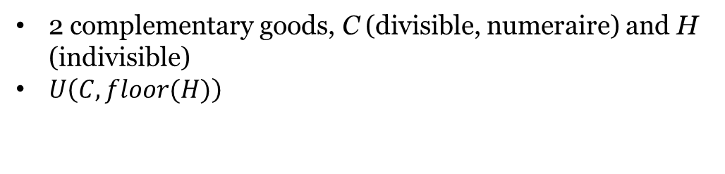
Model
Stage 0
Stage 1
2 complementary goods, C (divisible, numeraire) and H (indivisible)
$U\left(C,floor(H)\right)$

Slide 12


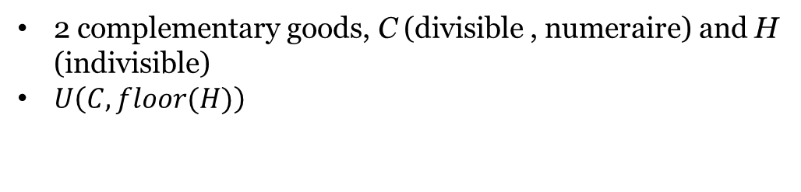
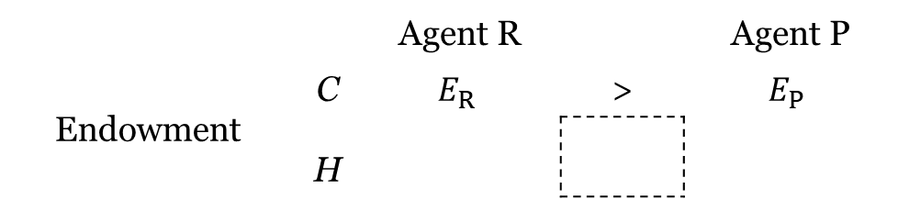
Model
Stage 0
Stage 1
2 complementary goods, C (divisible , numeraire) and H (indivisible)
$U\left(C,floor(H)\right)$
 |  | Agent R |  | Agent P
Endowment | C | $$E_{R}$$ | > | $$E_{P}$$
 | H

Slide 13
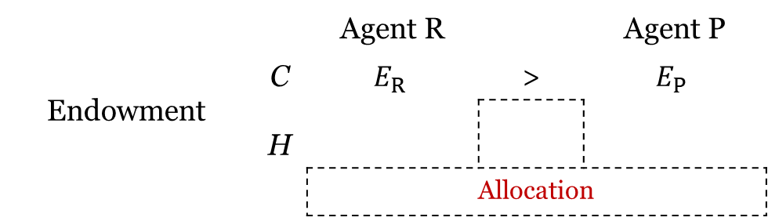
Model
Stage 0
Stage 1
2 complementary goods, C (divisible , numeraire) and H (indivisible)
$U\left(C,floor(H)\right)$
 |  | Agent R |  | Agent P
Endowment | C | $$E_{R}$$ | > | $$E_{P}$$
 | H
 |  | Allocation

Slide 14
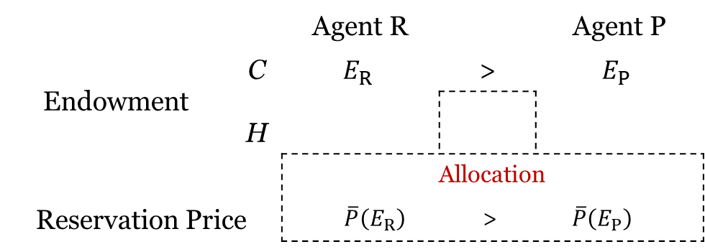
Model
Stage 0
Stage 1
2 complementary goods, C (divisible , numeraire) and H (indivisible)
$U\left(C,floor(H)\right)$
 |  | Agent R |  |  | Agent 2 | Agent P
Endowment | C | $$E_{R}$$ | > | > | $$E_{2}$$ | $$E_{P}$$
 | H
 |  | Allocation
Reservation Price |  | $$\overline{P}\left(E_{R}\right)$$ |  | > | $$\overline{P}\left(E_{P}\right)$$

Slide 15
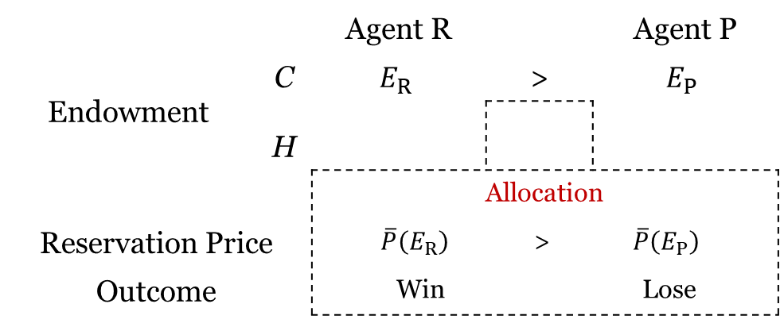
Model
Stage 0
Stage 1
2 complementary goods, C (divisible , numeraire) and H (indivisible)
$U\left(C,floor(H)\right)$
 |  | Agent R |  |  | Agent 2 | Agent P
Endowment | C | $$E_{R}$$ | > | > | $$E_{2}$$ | $$E_{P}$$
 | H
 |  | Allocation
Reservation Price |  | $$\overline{P}\left(E_{R}\right)$$ |  | > | $$\overline{P}\left(E_{P}\right)$$
Outcome |  | Win |  |  | Lose

Slide 16
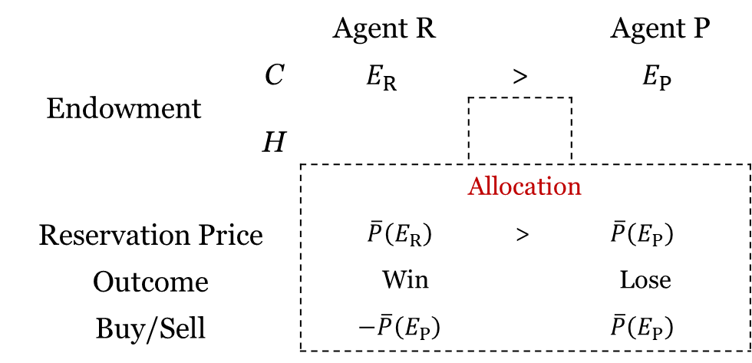
Model
Stage 0
Stage 1
2 complementary goods, C (divisible , numeraire) and H (indivisible)
$U\left(C,floor(H)\right)$
 |  | Agent R |  |  | Agent 2 | Agent P
Endowment | C | $$E_{R}$$ | > | > | $$E_{2}$$ | $$E_{P}$$
 | H
 |  | Allocation
Reservation Price |  | $$\overline{P}\left(E_{R}\right)$$ |  | > | $$\overline{P}\left(E_{P}\right)$$
Outcome |  | Win |  |  | Lose
Buy/Sell |  | $$−\overline{P}\left(E_{P}\right)$$ |  |  | $$\overline{P}\left(E_{P}\right)$$

Slide 17
Model
Stage 0
Stage 1
2 complementary goods, C (divisible , numeraire) and H (indivisible)
$U\left(C,floor(H)\right)$
 |  | Agent R |  |  | Agent 2 | Agent P
Endowment | C | $$E_{R}$$ | > | > | $$E_{2}$$ | $$E_{P}$$
 | H
 |  | Allocation
Reservation Price |  | $$\overline{P}\left(E_{R}\right)$$ |  | > | $$\overline{P}\left(E_{P}\right)$$
Outcome |  | Win |  |  | Lose
Buy/Sell |  | $$−\overline{P}\left(E_{P}\right)$$ |  |  | $$\overline{P}\left(E_{P}\right)$$

Slide 18
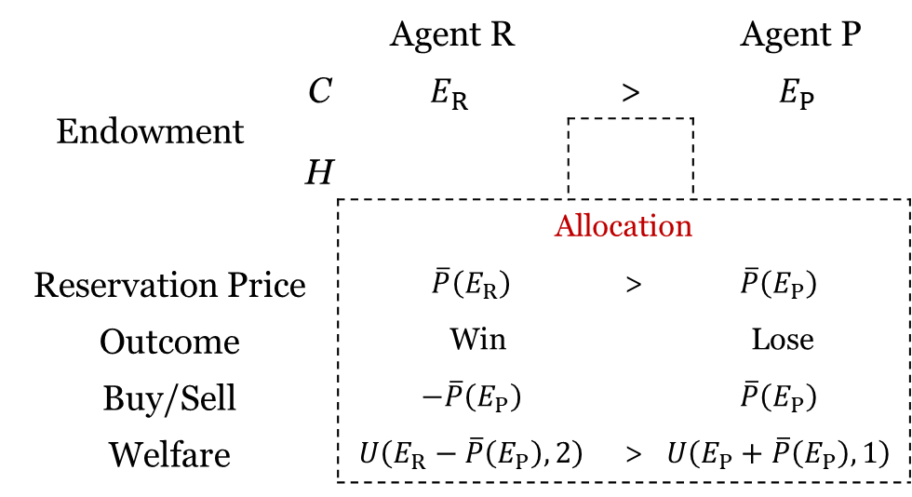
Model
Stage 0
Stage 1
2 complementary goods, C (divisible , numeraire) and H (indivisible)
$U\left(C,floor(H)\right)$
 |  | Agent R |  |  | Agent 2 | Agent P
Endowment | C | $$E_{R}$$ | > | > | $$E_{2}$$ | $$E_{P}$$
 | H
 |  | Allocation
Reservation Price |  | $$\overline{P}\left(E_{R}\right)$$ |  | > | $$\overline{P}\left(E_{P}\right)$$
Outcome |  | Win |  |  | Lose
Buy/Sell |  | $$−\overline{P}\left(E_{P}\right)$$ |  |  | $$\overline{P}\left(E_{P}\right)$$
Welfare |  | $$U\left(E_{R}−\overline{P}\left(E_{P}\right),2\right)$$ |  | > | $$U\left(E_{P}+\overline{P}\left(E_{P}\right),1\right)$$

Slide 19
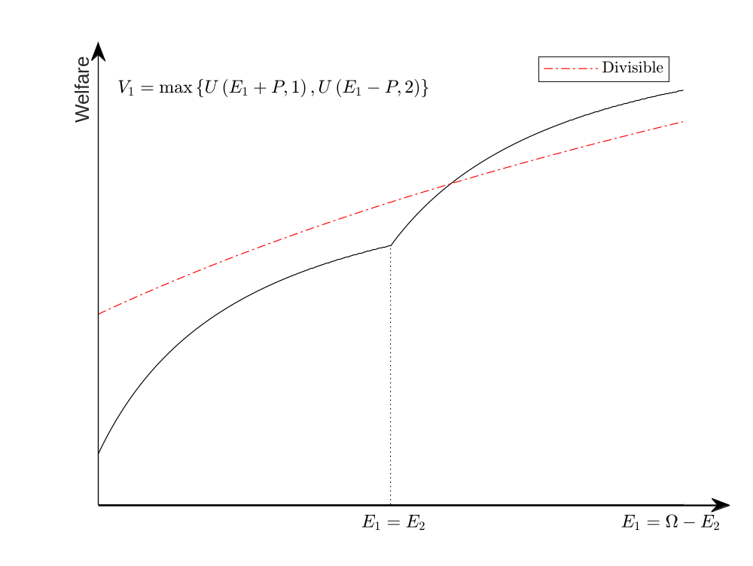
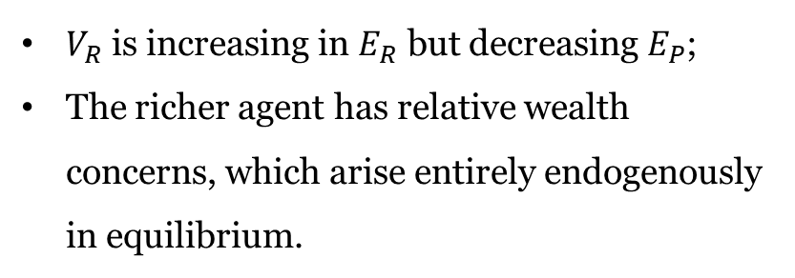
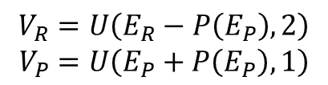
Results
Indirect utility
$$V_{R}=U\left(E_{R}−P\left(E_{P}\right),2\right)$$
$$V_{P}=U\left(E_{P}+P\left(E_{P}\right),1\right)$$
$V_{R}$ is increasing in $E_{R}$ but decreasing $E_{P}$;
The richer agent has relative wealth concerns, which arise entirely endogenously in equilibrium.

Slide 20
Thank you!

