Slide 1
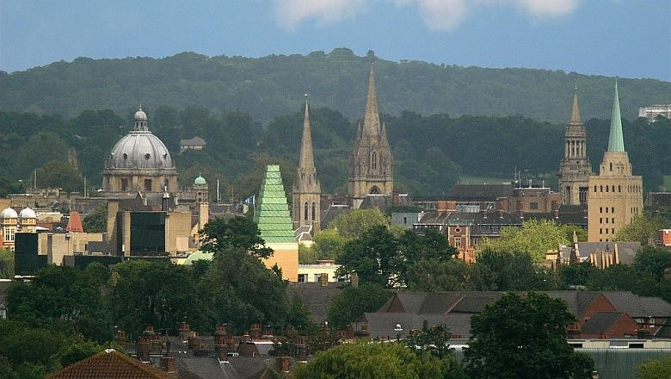
What finance, economics and history teaches us about the next decade
Ken Okamura
LV2026

Slide 2
Who should we ask about the size of the AI market?
The equity market!

Slide 3
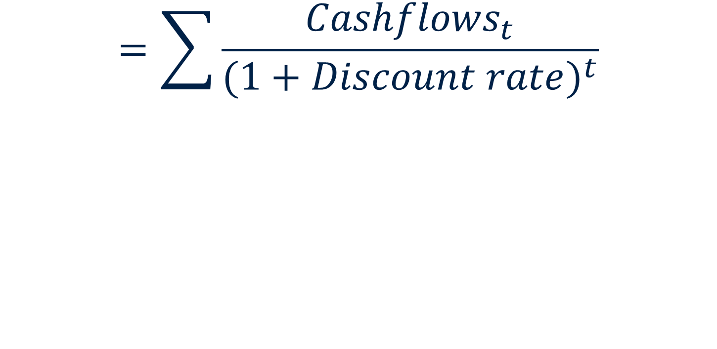
$$Present value of project$$
$$=\sum{\frac{{Cashflows}_{t}}{{(1+Discount rate)}^{t}}}$$
Invest in positive Net Present Value (NPV) projects
If you have limited resources invest in highest NPV
projects

Slide 4
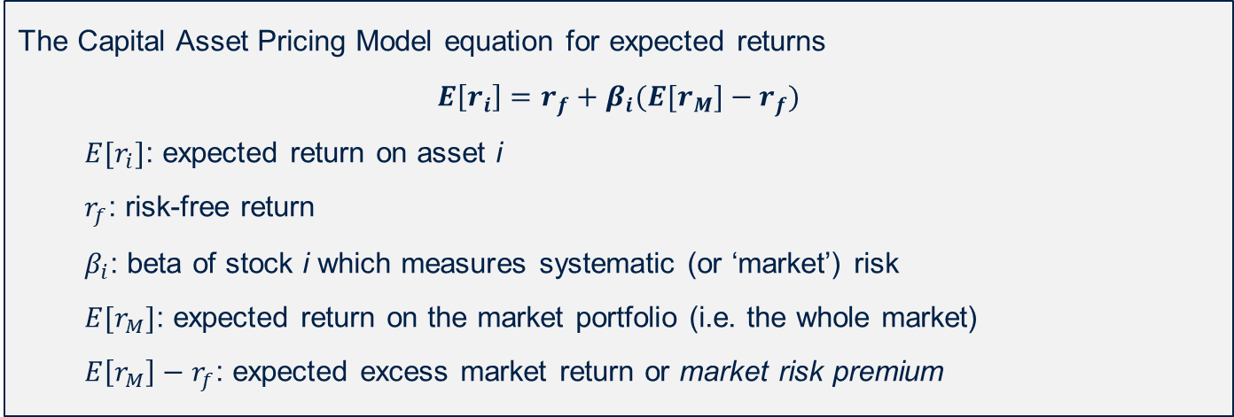
NVIDIA’s cost of Equity
The Capital Asset Pricing Model equation for expected returns
$$E\left[r_{i}\right]=r_{f}+β_{i}(E[r_{M}]−r_{f})$$
  $E[r_{i}]$: expected return on asset i
  $r_{f}$: risk-free return
  $β_{i}$: beta of stock i which measures systematic (or ‘market’) risk
  $E[r_{M}]$: expected return on the market portfolio (i.e. the whole market)
  $E\left[r_{M}\right]−r_{f}$: expected excess market return or market risk premium
Beta of NVIDIA: 2.22 (S&P CapitalIQ)
Risk free rate:4.73% (US 10 year Treasury)
Expected return on the market: 4.23% (Damodaran Online)
14.12% = 4.73% + 2.22 x (4.23%)

Slide 5
Tax-adjusted Weighted Average Cost of Capital (WACC)
Nvidia is not just equity funded, it has excess cash = negative debt
Equity: US$5,505 billion
Net Debt: -US$ 24 billion
Debt cost: 5.22% (AA US Corporates S&P Capital IQ)
Tax rate: 21% (last twelve months 16%)
Tax adjusted WACC =
-26/5481 x 5.22% x (1-21%) + 5505/5481 x 14.12%
= 14.18%

Slide 6
$$Present value of project$$
$$=\sum{\frac{{Cashflows}_{t}}{{(1+Discount rate)}^{t}}}$$
Where do we find the cashflows?
Use consensus forecasts

Slide 7
NVIDIA Free Cash Flow in US$ millions
Forecast
Source: Capital IQ

Slide 8
NVIDIA Free Cash Flow in US$ millions
Forecast
Source: Capital IQ

Slide 9

Do the numbers add up?
Value of projected cashflows to 2036 are $2.4 trillion
Current value of NVIDIA is $5.48 trillion
How to fill the gap? Use growing perpetuity formula for terminal value (growth past 2036)
$$PV= \frac{CF}{(r−g)}$$
Requires growth to be 6.5% in perpetuity
(that’s too high – LT growth = 3%)

Slide 10
What do the 2036 forecasts show?
Revenues: US$ 1.5 trillion
Net Income: US$723 billion
Net income is about 90% of FCF

Slide 11
Need some better numbers!
Substitute in US$ 1.1 trillion in FCF in 2036 and assume declining growth from 2031 to 2036 (perpetuity growth = 3%)
Assume net income x 0.9 = FCF
In January 2026 net income margin was 55.6% and gross margin was 71%
In 2015 (more normal) net income margin was 13.5% and gross margin was 55.5%
Revenue range in 2036 is between $1.8 trillion and $7.3 trillion

Slide 12
Extrapolate from NVIDIA revenues
Taking mid-point of $4.6 trillion (1.8 low, 7.3 high)
Assume that spending on NVIDIA’s chipsets and services = infrastructure spending on AI
Infrastructure spending is 1/3 of total AI expenditures and NVIDIA gets 50% of total spending
Implies total AI sales is $27.6 trillion and that Value Added is around $14 trillion
Compare to total global GDP of $126 trillion, growing at nominal 3% means that in 2036 is US$169 trillion (AI is 8.3% of GDP)
Notes:
In the optimistic case AI is 17.4% of GDP

Slide 13
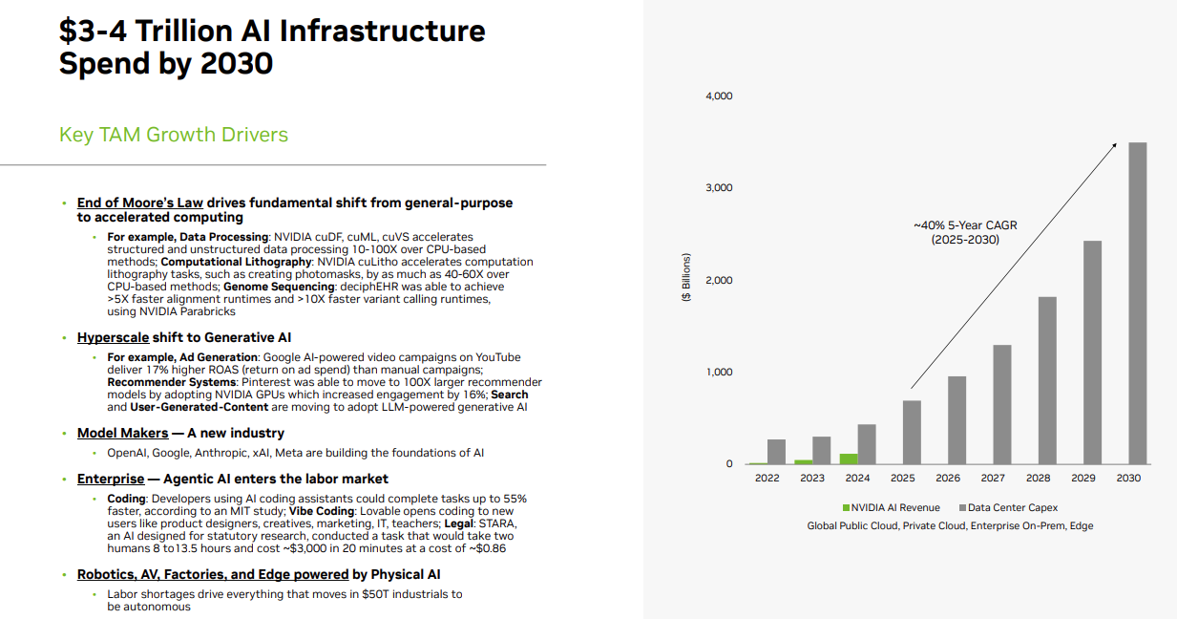
In line with NVIDIA forecast
Source: NVIDIA

Slide 14
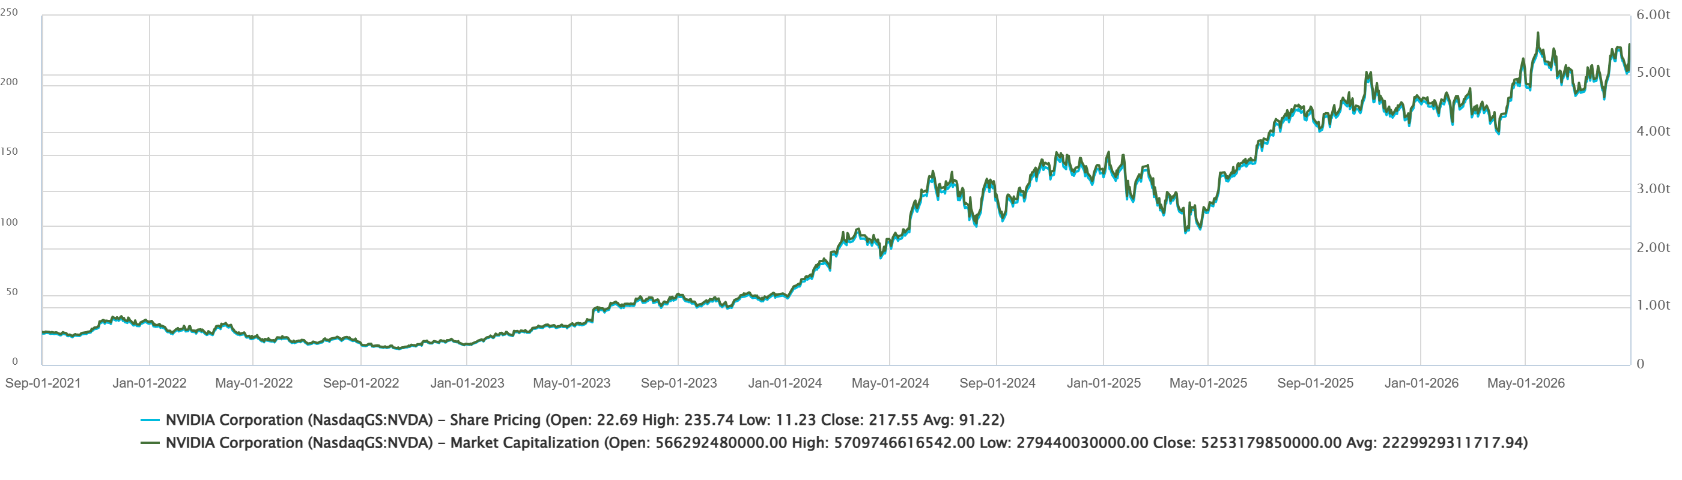
The market remains optimistic
Nvidia’s share price & market cap

Slide 15
Is it a bubble?

Slide 16
What leads to a boom and bust cycle?
Minsky cycles (post-Keynesian)
Boom – new technology
Eventually speculative finance takes root
Excessive investment as asset prices rise above correct price
“Minsky Moment” when correction takes place

Slide 17
“The AI investment race” BIS working paper July 2026
Rungcharoenkitkul
Rungcharoenkitkul (2026) shows how the Minsky cycle could be happening in AI boom
Looks at investment players (five big groups) and models competition and financing
Identifies difference between private and social benefits to explain potential over-investment
Also shows how market structure likely to lead to “firesales”
Furthermore, network links between players increases the likelihood of a crisis due to contagion
Notes:
https://www.bis.org/publications/working-paper-1367-ai-investment-race.pdf

Slide 18
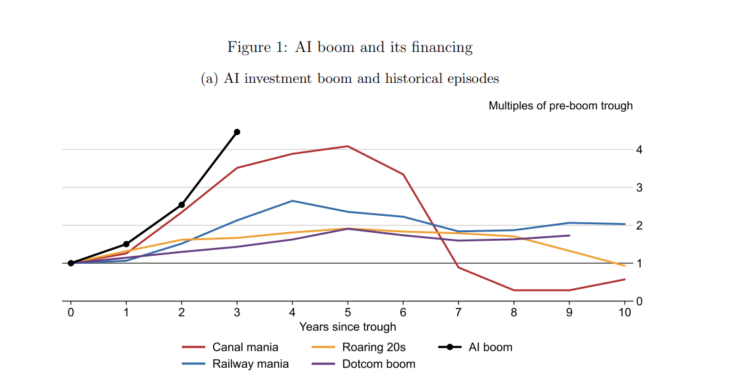
How AI boom compared to past booms
Panel (a) shows investment during five innovation-led booms as multiples of each episode’s pre-boom trough: canals (US, from 1835), railways (GB, from 1843), the 1920s (US, from 1921), dotcom (US, from 1995) and AI hyperscaler capex (from 2023, with 2026 from announced guidance).

Slide 19
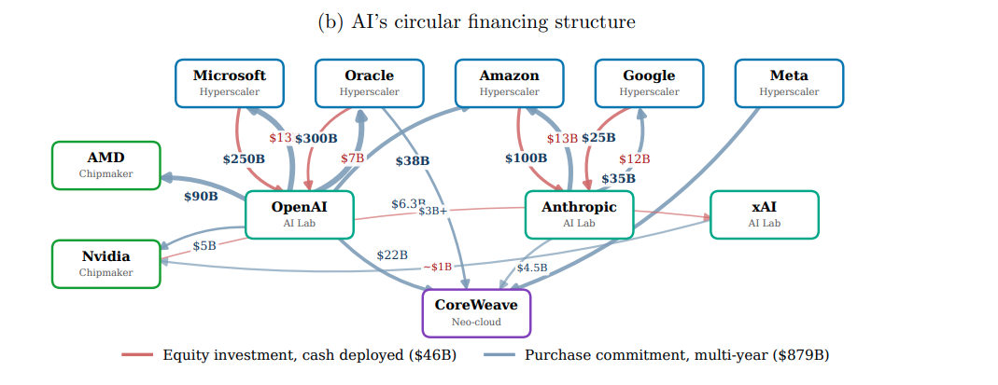
It’s all about circularity
Panel (b) shows the network of equity stakes and compute-purchase commitments linking hyperscalers, chipmakers, AI labs and the leading neocloud, with thicker edges for larger deals. Sources: SEC filings (10-K, 10-Q, 8-K), company announcements, earnings-call guidance, and financial press.

Slide 20
How does the model work
Three period model
There are coalitions of hyperscalers and AI labs (treated as single decision maker and all the same) ( In reality five coalitions
In period 1 Each coalition invests (equity and debt) into AI investment
In period 2 There is a productivity draw (we find out how useful AI is) ρ is between 0 and 2, where ρ>1 is good and ρ<1 is bad, coalitions decide how much to invest in period 2 after seeing productivity, θ is between 0 and 1, and decides how much of a disadvantage it is to build in period 2 rather than period 1
In period 3 investment payoff is resolved and equity and debt paid off
Investments in period 1 and 2 decide its “compute”, but there are constraints ν between 0 and 1, which represents supply constraints, and there is circular financing in the form of γ_{k} which is the dual hold up problem of hyperscalers wanting to lock in demand for build out of compute, but lab cannot commit to purchase. Hyperscaler achieves this through taking an equity stake in lab. (“circular financing”)
ε is the “headstart” elasticity, it must be >0 and indicates the extent to which only period 1 capacity can capture contest share determined in period 3. (This determines the extent to which debt is decided in period 1)

Slide 21
Decisions and constraints
Each coalition must choose investment in period 1 taking into account others actions
As each is trying to steal a march on others, the Nash Equilibrium is for individual coalitions to overinvest relative to an optimal social planner
Coalitions desire to win the race leads to overcommitment in period 1, to excess reliance on circular finance in period 1 (as compute is a function of synergies between two members of coalition)
There is a firesale and leverage increase of the size of the bust

Slide 22
What happens in the model?
Rungcharoenkitkul (2026) calibrates their model. Five groups (Amazon, Google, Meta, Microsoft, Oracle) hyperscalers and (Anthropic, Deepmind, MetaAI, OpenAI, xAI) labs
ν = 0.7, θ = 0.85, ε = 0.2 (this ranges from above 1 in consumer market to near zero in business markets). The elasticity suggests debt share as being 30%
Results: Compute over-investment of 1.34x and dollar over-investment of 1.51 x
The internal model equilibrium places the required productivity draw as ρ=1, but the required level of productivity gains rises as the period 1 investment rises
Paper concludes that baseline assumptions suggest even chance of bust
If a bust occurs, all coalitions will suffer failure simultaneously as it is a common productivity shock (aside: Is this true?)

Slide 23
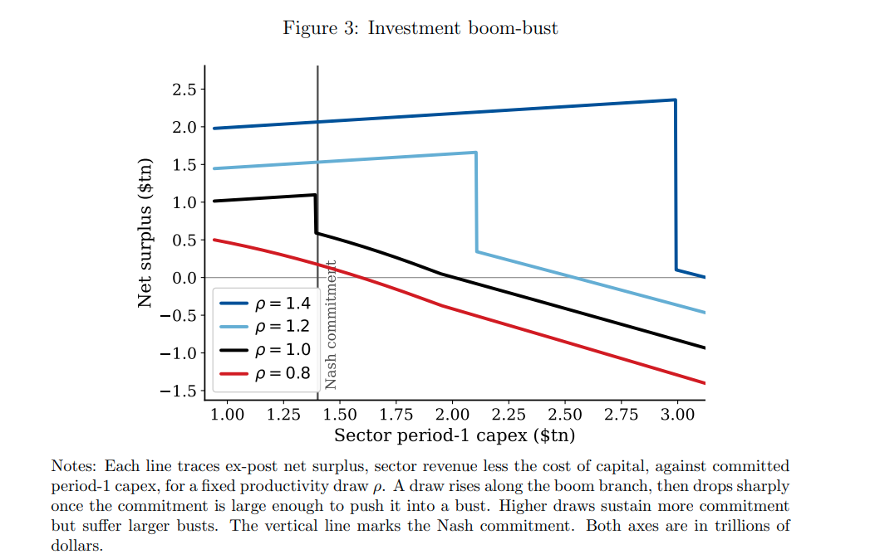
Social surplus based on period one investment

Slide 24
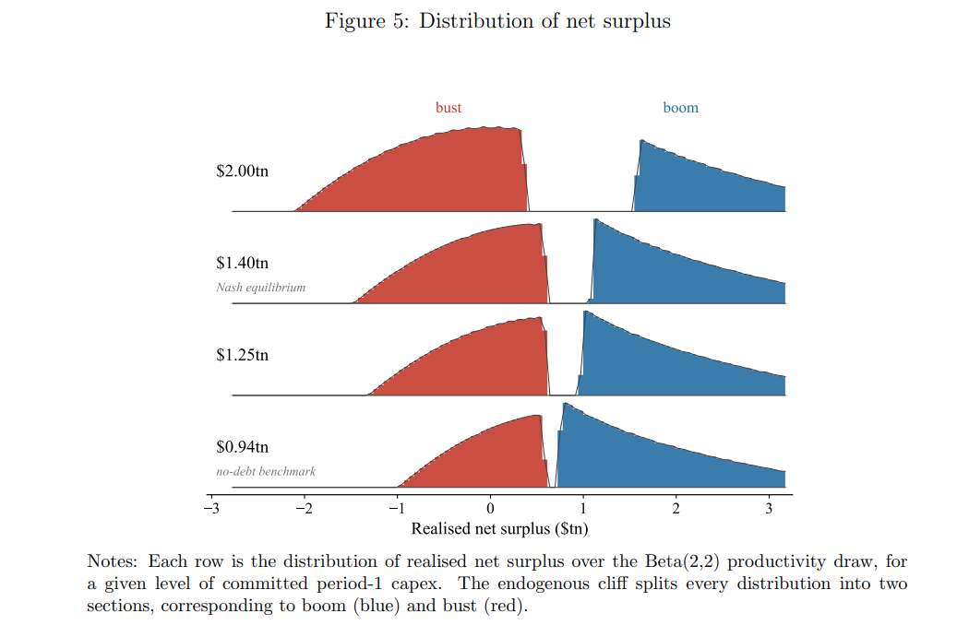
Depending on beta (productivity) boom or bust

Slide 25
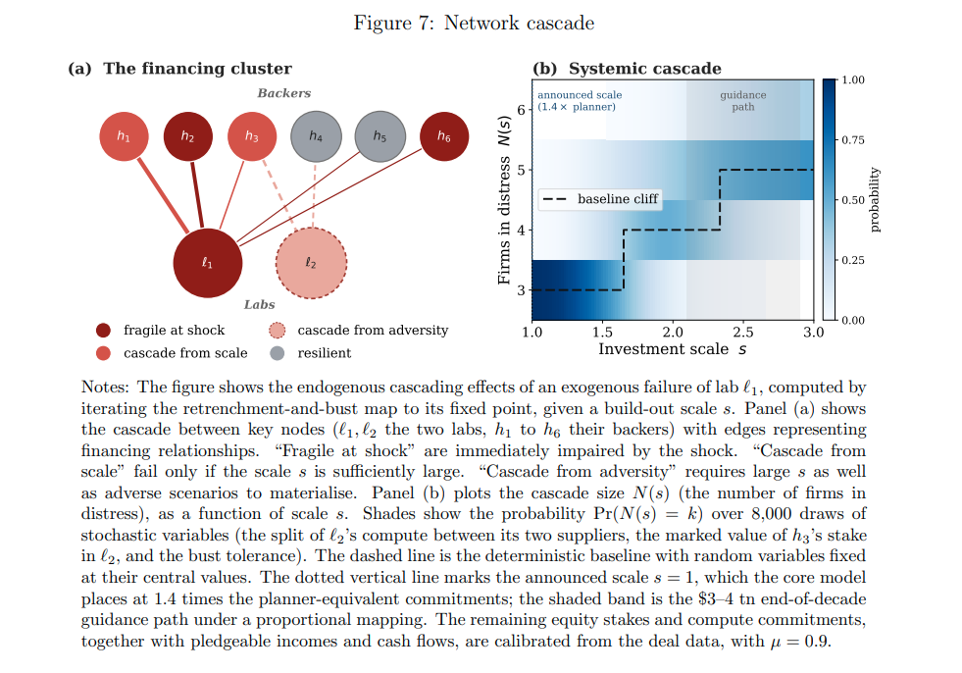
Possible network contagion

Slide 26
How large is the impact of AI?
Acemoglu (May 2024)
Using a task based model of AI and assuming automation and task complementarities
  20% of US task are exposed and 23% can be done by AI and cost savings are 27%
Estimated effect over 10 years is 0.66% increase in TFP (or 0.064% annually)
  GDP will increase more due to investment but consumption declines
Will increase inequality and especially gap between capital and labour income
Aghion and Bunel (June 2024)
Use same methodology as Acemoglu 2024
Different assumptions about impact and applicability
Estimated annual increase in TFP of between 0.07pp and 1.24pp with a median of 0.68pp
Note annual TFP in US has been 0.65% between 1990 and 2019
Notes:
https://www.nber.org/system/files/working_papers/w32487/w32487.pdf
Hemous (2025) January
Goldman Sachs (2023) estimated a 7% increase in GDP within 10 years
ChatGPT 3.5 estimated that TFP would increase by 1pp annually and ChatGPT 4.0 predicted an increase of 0.5pp to 2.5pp
https://watermark02.silverchair.com/eiae061.pdf?token=AQECAHi208BE49Ooan9kkhW_Ercy7Dm3ZL_9Cf3qfKAc485ysgAAA5EwggONBgkqhkiG9w0BBwagggN-MIIDegIBADCCA3MGCSqGSIb3DQEHATAeBglghkgBZQMEAS4wEQQMGc1fu06gBqAmRBmyAgEQgIIDRCdl4OuSl7SijbG-TUansp5vd-bsRR5mAvhW6uNw1ilKapvMeQKnJZjafhmyp-zm8SAoyrP-9wPuSeUZC8XcpXnYuFco_rfsYkxQyN4pFjqYQG8M1DMeV2PSpg7p4U85kndSvRlFQlk75LueWRaN3ljkb3HASkcWZU3FuDSwYh7W9R-faCC7L8UxUUc1TLNdVKbGKZ26pMBa5FxFmzzTd7WgiVMA5jTk8jLU_KGdv8fhQSsZvoujklewpX6bW7B-8YAu4DeG0mWRm6fbK9hn-iy9B_Oo1ZabLTdOTlrySgqSQtRbviJ-0u7AdDWSWjzjhvI4PYa5gkjJYvK23VA7qLq6zmXCwFQoRVwO1jsrF4fiDMXbpyYFlP61osxIKlZTejhRCGUgj-cQu_D4RY2n9zQ87D6LA5RMpQnJ9XxXb99cCXIWaB6Yq60iNlWpyhsDai8dA2_b9XXxGoTZkvPT4wYK2DgWD5XDMSJ8PBOyJSikDO2T9YMJLuJBZINN5QsCvuKAEpYGfMPBRd5WoeJkPHbRujN02gs4U1RIefDfPh6AkGVEYnEDmG1I7kBsivd8qNK9OIB34KT44x6A4swVs3WSwk1_GPdVu67BjWxlyU9Crrvc7hXuyPCe9LR0Z5ZJ1NSNKJzZsXGcIxzig8qiD6IdQCTY60qLgnWfFfbf91Tkr3FhsWRnNfJ5F8_0GBWymK8Gvvi5mkap4v_bEHQcDNxqmBoU3z2fE5Qgy9ag4m_-jgSXPpHtebYSJ6LtYFi4NC1y5bBwQl-VGKwS5VGhuWGNvQ-sCaWtlIIFSittN5YGD6FudA19SjJa9N19kG2ULNxb_QX2d066AX7tQ1iGC_AmhQ3FfJ0_cGWos4bSM6WqKyWN6v5ZaQi-W04C48OvJ-62pw3uJ_wJuJjlpsGwFSSjwlz84T1iFQQvDShnRXak20qN6AuLx8tCvOZtv1YhoUts8Vj57HEcJWgbXhJx8dNtpiEpaxm7hyR3tzubZLXi6IwGiogUXnRzGZi_cKBV_qXuSNKN-psYY1Hb2y8vvA_GEDGJMt2ULQaq0GKuE6iGj20jorFAPCXvqxaImAUlrsciP4kmSEJ7aWuQLKR93EtuQYNM
https://www.dropbox.com/scl/fi/s39aefeaximl8yudcgbmf/ab_ai_growth.pdf?rlkey=2uq2k1ovmrywmn75iy1bgjvrv&e=1&dl=0

Slide 27
Who’s right? And what does it mean?
If Acemoglu is correct – AI investment will fall
If Aghion and Bunel are right, AI investment will rise more than expected but the disruption will be huge

Slide 28
In 10 years what does Acemoglu (2024) and Aghion and Bunel (2024) imply for the US economy?
Acemoglu
GDP in 2036 will be higher by $240-400 billion (<1%)
Incremental capital income is $80 billion
Labour savings are 4.6% (tasks)
Gross jobs displaced: 3-8 million (central = 5 million)
Aghion and Bunel
GDP in 2036 will be higher by $3.5 trillion (7%)
Incremental capital income is $1.4 trillion
Labour savings are 30% (tasks)
Gross jobs displaced 15-50 million (Central = 30 million)
Double this for EU + UK + Japan + South Korea + Canada + Australia

Slide 29
Implied free cashflow to AI infrastructure (Rungcharoenkitkul 2026) players
Acemoglu estimate in 2036 would be $144 billion
Aghion and Bunel estimate in 2036 would be $2.5 trillion
(I’ve assumed 90% of capital income)
Aghion and Bunel estimate is roughly in line with the NVIDIA share price estimate
To get the $1.4 trillion being invested this year and next back, FCF over the next three or four years will have to generate at least as much as is being invested (with a lot of future growth built in). This would also be in line with Aghion and Bunel.
Total job losses over the next three to four years would then be equivalent to the ones envisaged in Acemoglu or 5 million in US, 10 million in the West.

Slide 30
Unemployment
Three big problems in estimating this:
At what point do the tasks being automated lead to job losses?
Increased employment due to increased demand?
Is the technology going to be value-additive? Or is it substituting for labour?
US labour force is 170 million (163 million employed, 7 million unemployed = 4.1% unemployment)
A rise in unemployment of 5 million, would raise unemployment rate to 7%

Slide 31
Assumptions
Studies typically suggest 55:45 split between augmentation and automation
Direct job losses according to Aghion and Bunel scenario would be 3-7 million by 2029 and jobs not created 7-15 million
New jobs will appear but impact on early career and those in threatened occupations
By 2036, total job losses are 30 million and jobs not created similar magnitude

Slide 32
Bad news
People don’t seem to be willing to pay for AI
Total revenues so far have been far lower than investments
Users do not want to pay for cutting edge models
Cheap models from China (and others) are available

Slide 33
AI will change the world
But, the winners may not be the current players – infrastructure provision may prove a loser (as it was for many canal builders and railway companies)
Exacerbated by short life of GPUs
It may take a while for winners to become clear and there may (probably will) be a crash in the meantime
Leverage, firesales and network contagion will make it much worse (I also worry about private credit and insurance/reinsurance companies roles in this)
Global governments already owe too much and interest rates are rising (inflation is a likely threat)

Slide 34
Threats to current AI
LLMs are stochastic parrots. They are never going to reach true generative AI
Alternate approaches to generative AI may work (Causal World Models)
May require a lot less data crunching (but there are alternative uses – eg self-driving cars)
Quantum computing

Slide 35
Who destroyed the New World Order?

Slide 36
"A hundred generations have searched for this elusive path to peace, while a thousand wars raged across the span of human endeavor. Today that new world is struggling to be born, a world quite different from the one we've known“ President George Bush 1990

Slide 37
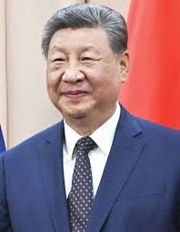
A great Chinese leader, but bad for the world

Slide 38
Being rich has implications 2

Slide 39
Being rich has implications 2
1987 – Taiwan lifts martial law

Slide 40
Pre-Xi (2013)
From 2002, seven up, eight down meant expected retirement age was 68
Many factions existed within CCP, experimentation by party leaders permitted within provinces
County level elections without party membership permitted
“One country, Two systems” in place for Hong Kong
China was a semi-trusted partner of the West

Slide 41
Post-Xi
2018 saw low level democracy cancelled outright
Major crackdowns on democracy movement in Hong Kong
Factions removed from top three levels of CCP
Xi abolished term and age limits
No more experimentation at provincial level by senior leaders other than Xi
Massive expansion of PLA budget and military muscle
Aggressive pursuit of territorial claims in South China Sea
Border conflict with India 2020-2021

Slide 42
Western response
China no longer seen as a semi-trusted partner
Neighbouring countries (ASEAN and Japan) have gone into a major military expansion
De-risking China exposure (cutting down supplier risks)
Increasing confrontation over human rights abuses

Slide 43
China’s actions
BRI or OBOR – China has invested, loaned and given aid of over $1.4 trillion since 2013
China has been more generous to countries that are less popular with West over governance issues
Double the funding of West in SSA for infrastructure since 2013
Chinese loans more expensive but with less governance strings attached
China has set up a patchwork alternate payments system that allows firms to avoid Western sanctions
Renmimbi payments peak at 4.7% of SWIFT payments in July 2024

Slide 44
Without China drifting away from the West
Would Russia have invaded Ukraine?
Would there be so many coups in sub-Saharan Africa?
Would there have been less adventurism by Iran?
Would bad leaders like Rajapaksas in Sri Lanka or Maduro in Venezuela or Orban in Hungary have been less durable?
Would money laundering be more difficult?

Slide 45
Next stage
Optimistic
Next paramount Chinese leader is willing to align with the West more
Eventual economic slowdown is ridden out without domestic tensions exploding
Pessimistic
Domestic economic slowdown leads to:
  Rising tension over Taiwan/South China Sea
  More confrontation with the West
  Civil war?

Slide 46
Timeline of Major Chinese Civil Conflicts
Period / Conflict | Conflict Dates | Estimated Deaths | Est. % Pop. Loss
Warring States Period | 475 BC – 221 BC | Millions | ~20% – 30%
Qin-Han Transition | 209 BC – 202 BC | Multi-million | ~30% – 50%
Fall of Wang Mang | 9 AD – 25 AD | Over 10 million | ~30% – 40%
Three Kingdoms Period | 184 AD – 280 AD | 35 – 40 million | ~60% – 70%
An Lushan Rebellion | 755 AD – 763 AD | 13 – 36 million | ~25% – 50%
Fall of the Tang | 874 AD – 960 AD | Millions | ~30%
Yuan-Ming Transition | 1351 AD – 1368 AD | Over 10 million | ~15% – 25%
Ming-Qing Transition | 1618 AD – 1683 AD | ~25 million | ~15% – 20%
Taiping Rebellion | 1850 AD – 1864 AD | 20 – 30 million | ~5% – 8%
Chinese Civil War | 1927 AD – 1949 AD | 6 – 10 million | ~1.5% – 2%

Slide 47
A bright spot

Slide 48
Obesity costs
Okunogbe et al. (2022) estimated economic effects of obesity for 161 countries
In 2019, the effect of Overweight and Obesity (OAO) is 2.19% of global GDP
From $20 per capita in Africa to $872 per capita in Americas
By 2060 estimated that this will rise to 3.29% of GDP
Notes:
https://gh.bmj.com/content/7/9/e009773

Slide 49
GLP-1 receptor agonists
Semaglutide (Wegovy/Ozempic) and Tirzepatide (Mounjaro/Zepbound) reduce obesity
Originally for diabetes now widely used for obesity
Weight loss between 10-20%
Most successful treatment for OAO
In 2025 a RAND study estimated 12% of US adults tried GLP-1 agonists, another 14% interested in using
Notes:
https://www.rand.org/news/press/2025/08/nearly-12-percent-of-americans-have-used-glp-1-weight.html#:~:text=Nearly%2012%20percent%20of%20Americans%20have%20used%20GLP%2D1%20drugs,April%20and%20May%20of%202025.

Slide 50
US obesity
US population estimated to be overweight or obese increased from 10.4% in 2019 to 15.7% in 2024
In FAIR Health data 4% of patients are on GLP-1s
Bulk are still diabetics rather than OAO (2% had prescription)
Some significant side-effects reported
Notes:
https://s3.amazonaws.com/media2.fairhealth.org/whitepaper/asset/Obesity%20and%20GLP-1%20Drugs%20-%20A%20FAIR%20Health%20White%20Paper.pdf

Slide 51
Patent expiry
Semaglutide: In Europe early 2030s, in Canada 2026, India, China, Brazil and Turkey have regulatory exclusions and expiries in 2026. In US, early 2030s (some protective patent thickets run until 2041)
Tirzepatide: In US 2036 and with other patents possibly 2041. In Europe mid-2030s

Slide 52
Economic impact of GLP-1s
In the medium term (post patent expiry) should reach significant percentage of OAO
50% decline in cost of OAO is 1% of GDP
It’s much higher than AI estimates and a lot more certain
And GLP-1s and related drugs may do more…

Slide 53
O’Keefe et al. (2025) GLP-1s
Are associated with declines in Substance Abuse Disorders
  50% decline in alcohol use (drinks, binges)
  40% decline in opiode cravings, 40% decline overdoses
  32% decline in tobacco use disorder
  40% decline in cannabis use disorder
Are associated with decline in neurodegenerative diseases
  40% decline in risk of Alzheimers, vascular dementia, Parkinson’s (only Semaglutide)
Notes:
https://www.sciencedirect.com/science/article/pii/S0033062024001798#bb0375
https://pdf.sciencedirectassets.com/272179/1-s2.0-S1567576924X00041/1-s2.0-S1567576924020599/main.pdf?X-Amz-Security-Token=IQoJb3JpZ2luX2VjEPr%2F%2F%2F%2F%2F%2F%2F%2F%2F%2FwEaCXVzLWVhc3QtMSJIMEYCIQCWsDi%2BH9VKucKLHlrieI5bwc4St3RbdeAemzl0ZA0BNQIhAJf%2B%2BGAMy0ub6JtWcWiqSB%2FRbjK5J5XuOaYDOtNLrfIVKrIFCHMQBRoMMDU5MDAzNTQ2ODY1IgwKLHvDIPn2TOxTWLoqjwXYEGhEzPS63snY6qQFHXQ9YEgEUAXxcADWaYvUA3SMuLI0Iag%2FFBSvp5Wu87Q7Z8oFqw9vF5Su9Z0%2F8V4GuWMllxnV2MC2M9LDbxNIboWBoKZfAJ0Tq7BrcO246sCEo6vHQAGO20hwozxmhM2cnDq4JBlV1BNawYpNndZB%2Bo1Uqoi7LXwjlUZYkEdq%2FLpg%2BrhH5%2FoP%2FJ51N7AG%2FuuRL8AWVc0zx5P30ECESwS%2BFAqnKtUhbWX%2FIY%2FHrUZ0Jd4%2FlAs10MtssMLGGaKFOTH%2BBr9yJpgUqbetQPu2gxl8flc71LzWN09FJPZxfewhBMj3zpHPE6mDXF31oJr5C76X8bWGvEZ4RdiQ%2BihLkQaavYCXBlUm822A8h2PbTJgz7KNPmj5qNjx5z2QPCu72PdoonKk6nTAevMInk9s78LpCmAdY9A9nWTZccu1EXeuOt6W8bbnKkaVhc4PRUOpJSXvCxZmMe%2FvG4vi8ZrxqHTRGd1lrvifW6i9AS7LyWtiiH%2BDxLn0Dn3IRFqF2Q5e08bC94DjfWntfbUGCG0VS0TSxAWsNzUvDxPCnAumW9hSp0C9w3aShdyVvoLhxyOFUfbdgkMP4Snt%2B9uibOSNd7XXQFugx2bag2ZXsAMW9PpuYS4TauFtv6Y1zNUxouhm5uYDPsJn06piKF6Yxn8ZSxBx%2B%2FrpgFF6KoB5H4BeOqgFT3zXL%2BQozLTa0%2Ft4aiHJdQA9UWScY%2B9AL8M9PWBblu6LbM45DCCRb7A%2FpcfZV6prod4gtYILnlskpB%2BLOhXkYS%2F0%2BqOAXmAG3BehYztkIuEDgV%2FIzkZjvZ%2BQxkIL5wP%2BeV%2FJMI%2Bbk7xq5AkoYPUPWwuOTU%2BJU28Nbr7cktmzWbOju6p4MO2%2Fn8YGOrABfY2x1OtVO8PdJPThOzAWY2NNPxkN097WX7x9NrQnZMmWg69JIqcuhQBv2nHxazuyD673XmNtVOiXc2fV81GcXFm67jN8DYTSFba598%2FN9t27JK9HvHdIBkCqWS7sjlQnhRWI0wdgaYwxRyb%2FoNdPRJaTRvw%2FheT65xQ8vDapB%2FX%2Bol7AqrZBtLGdn6QL6u6yO%2Fdx3c6IXg7CpR0GFwtSWrwzKNrRp3y1PEc3CXHrTQI%3D&X-Amz-Algorithm=AWS4-HMAC-SHA256&X-Amz-Date=20250915T102118Z&X-Amz-SignedHeaders=host&X-Amz-Expires=300&X-Amz-Credential=ASIAQ3PHCVTY2TT3R7P2%2F20250915%2Fus-east-1%2Fs3%2Faws4_request&X-Amz-Signature=224d7fe6fc51967d5ba36b004524dfa1dd106dacc6066ecfd94ee282d8f503fd&hash=18c76930c875c2bf521509dcc5c99938c632ed4b9dfa75f309c137eeef9d4c3c&host=68042c943591013ac2b2430a89b270f6af2c76d8dfd086a07176afe7c76c2c61&pii=S1567576924020599&tid=spdf-18cb4ece-bcf9-4ea8-8913-6043d7ee5922&sid=5e5a7c353cfd9740085b0856ffb20022cbcegxrqb&type=client&tsoh=d3d3LnNjaWVuY2VkaXJlY3QuY29t&rh=d3d3LnNjaWVuY2VkaXJlY3QuY29t&ua=1d0d575101505055540a&rr=97f7657eefa53eb9&cc=gb

Slide 54
Economic cost of other conditions
Cost of alcohol addiction in the US estimates are between 0.9% and 2.8% of GDP
Costs of opioid addiction estimated to be around $1 trillion in 2017 (around half of this is reduced quality of life and loss of life) around 5% of GDP
Cost of caring for patients with Alzheimer’s and related dementias in US in 2020 estimated at direct cost of $196 billion and $254 billion in caregiver time (US GDP in 2020 is $21.35 trillion), total direct and indirect costs around 2.1% of GDP
Notes:
https://link.springer.com/article/10.1007/s40273-021-01031-8
https://www.sciencedirect.com/science/article/pii/S0376871620305159?casa_token=FKg2h7gD6agAAAAA:Cnr6ROGbE5rb38JNoURMSXdtiN6nOCfhl2obGmYhzPwFcM85-F0vJ7D-XPlylbACKVJb3YGiycc
https://www.nature.com/articles/s41514-024-00136-6

Slide 55
Reasons to be cautious
Have to stay on GLP-1s permanently, long term side-effects unknown
How much of cost will be reduced by reductions in OAO, addictions and neurodegenerative diseases?
Will there be jobs for (the newly healthy) people if AI has taken over?!

Slide 56
Thank you

